Slide 1

Autumn Term
Teaching and Learning Update

Slide 2
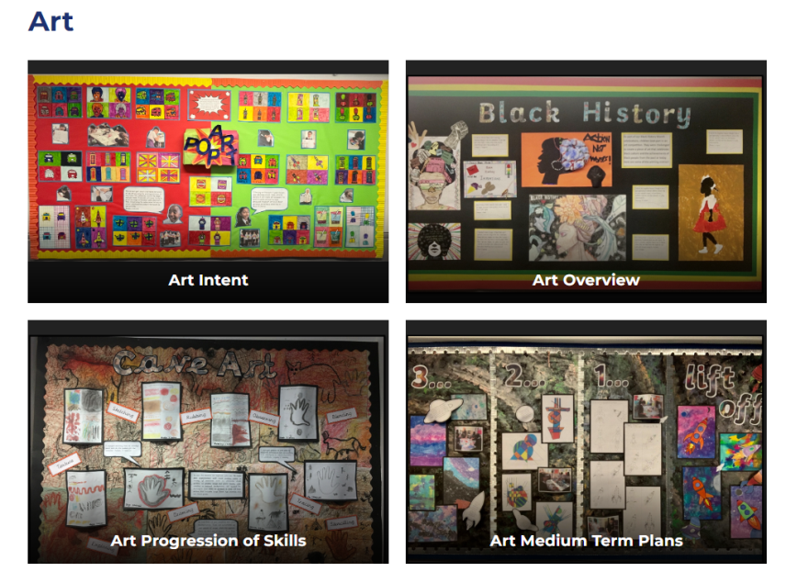

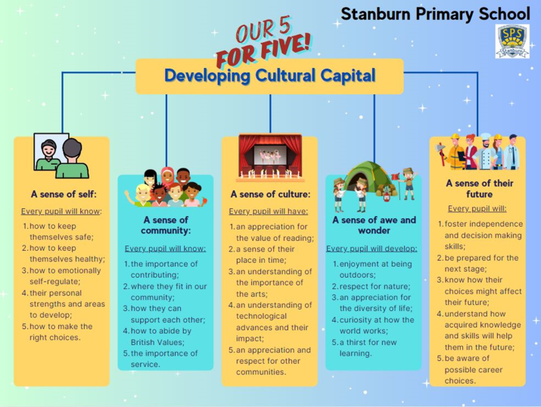
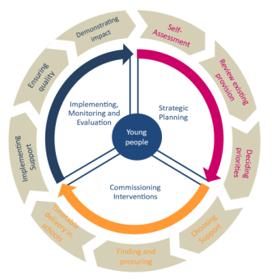

Quality of Education
Curriculum INTENT statements (VISAs) created for each subject and on our school website.
INTENT
Stanburn is also taking part in the Partnership for Inclusion of Neurodiversity in Schools:
Trips Overview 2024-25
Learning Enrichment at Stanburn
We are passionate about providing our pupils with a range of enrichment opportunities to support work which takes place within the classroom. Across the school year, pupils will attend a range of experiences both in school and out of school. Where possible, trips which take place outside of school will make use of the TfL’s travel scheme and pupils will walk to trips which are within a 30 minute walking radius of the school. In addition to this, all learning enrichment opportunities here at Stanburn Primary School link to one of ‘Our 5 for Five - Developing Cultural Capital’ statements:
Cultural Capital prioritised on the SDP:
3c. Cultural Capital in and out of the classroom will be developed.
The curriculum is ambitious and designed to give all learners, particularly the most disadvantaged and those with special educational needs or high needs, the knowledge and cultural capital they need to succeed in life.
(1)

Slide 3
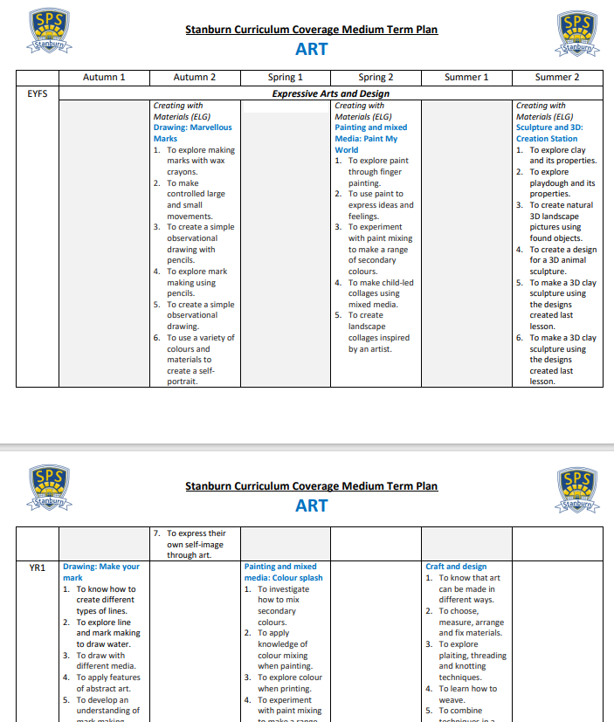
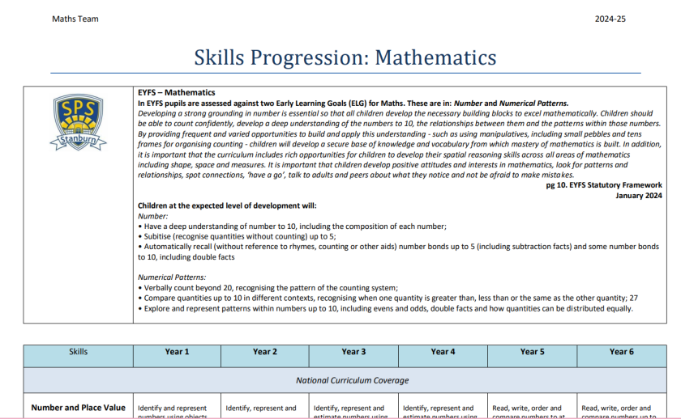
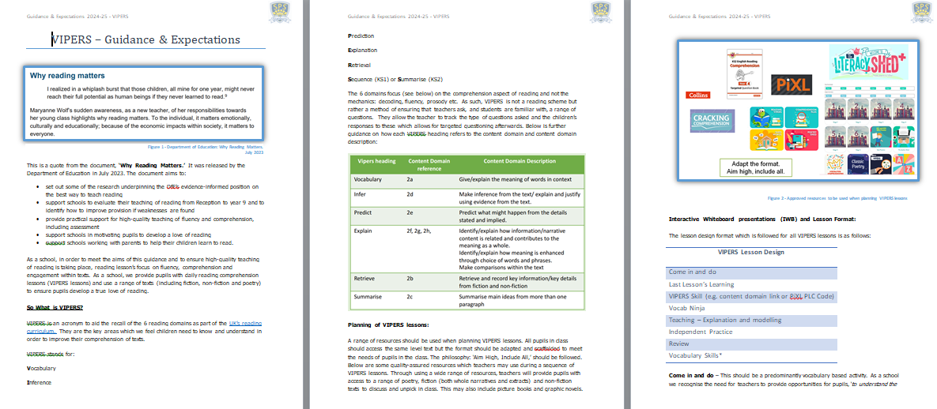
Quality of Education
INTENT
Medium Term Plans and Progression of Skills documents are being created for every subject:
Robust monitoring schedule to ensure all lessons and planning is in line with our school curriculum intent and Guidance and Expectations
The curriculum is coherently planned and sequenced towards cumulatively sufficient knowledge and skills for future learning and employment.
(2)

Slide 4
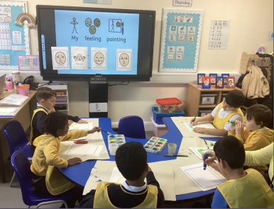

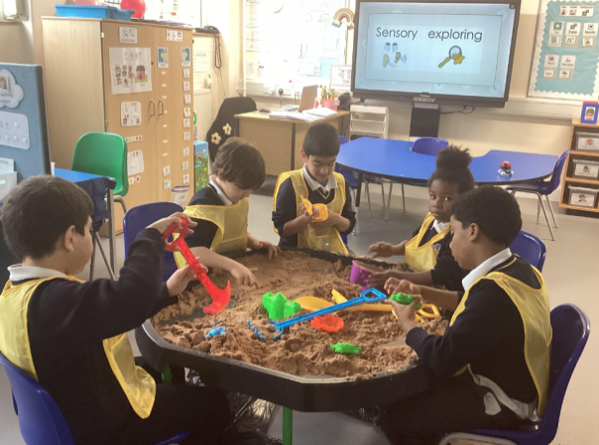
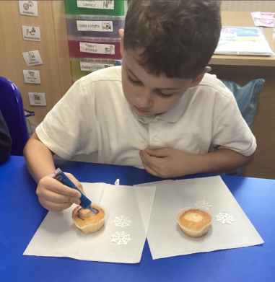

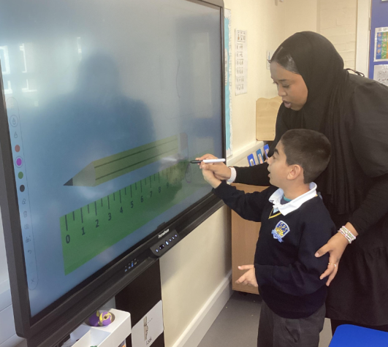

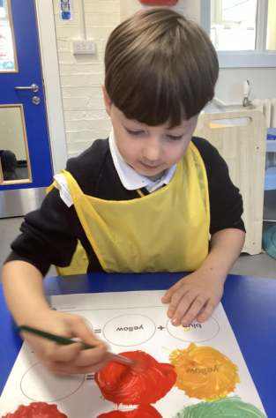
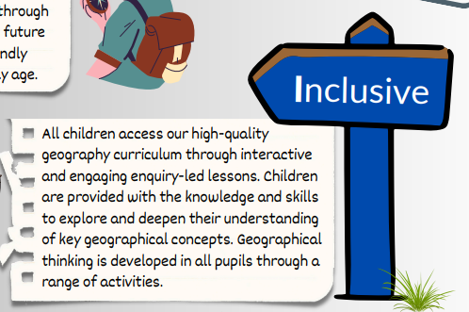
Quality of Education
Taking part in PINS Teaching and Learning Audit on Adaptive teaching to create personalised tool kit for adaptive teaching.
INTENT
CPD session for YLs on SEN linked to SEND – Teacher Handbook
VISAs have been created for every subject are with a focus on ‘inclusive’ practice.
The curriculum for SEND children is designed to be ambitious and to meet their needs.
(3)

Slide 5
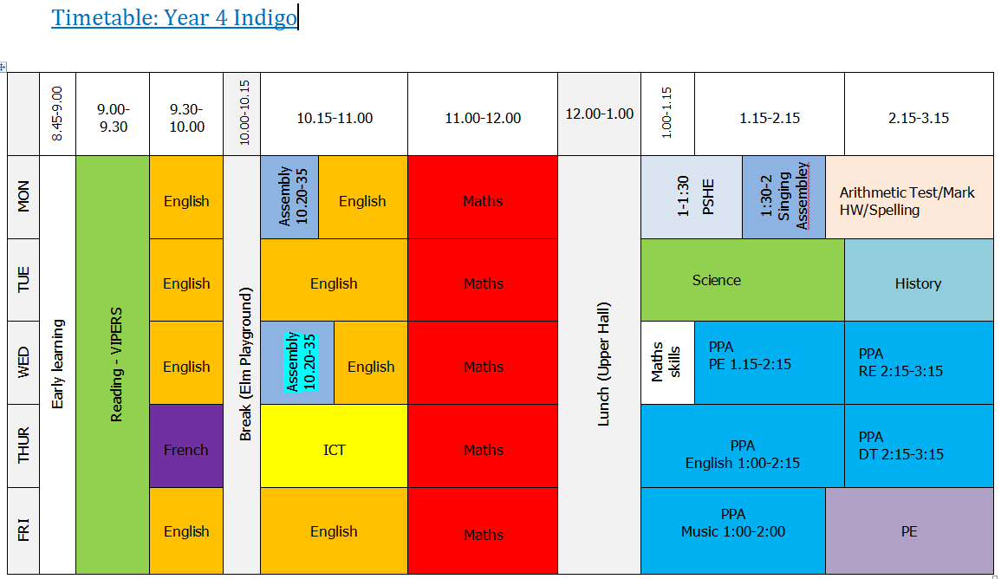
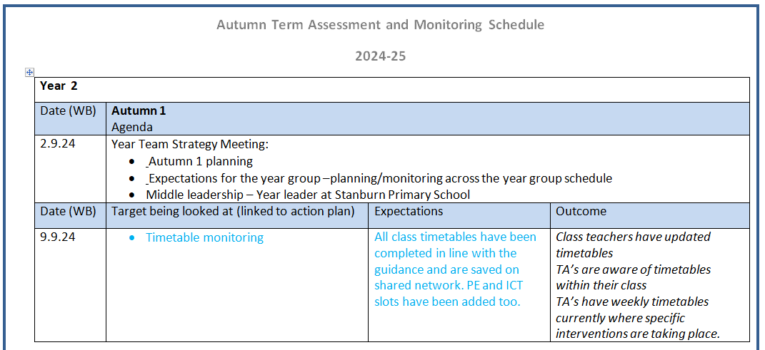
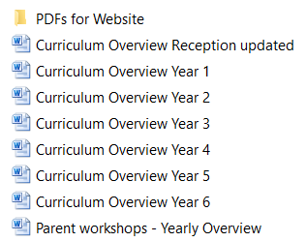
Quality of Education
INTENT
All class timetables are saved on the shared network. These have been checked by SLT and are monitored regularly by middle leaders as part of the weekly assessment and monitoring schedule.
Curriculum overviews have been created for each year group to show the full range of subjects taught in every year group for the academic year.
A full range of subjects is taught for as long as possible, ‘specialising’ only when necessary.
(4)

Slide 6
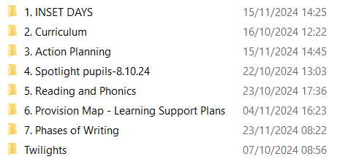
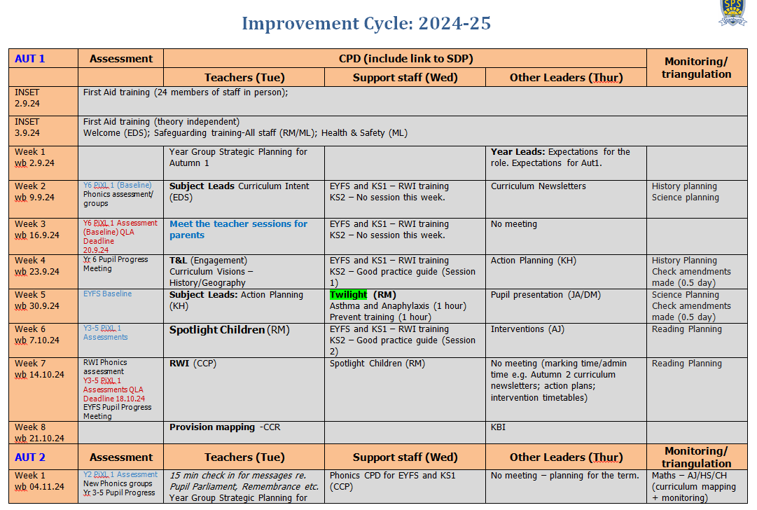

Quality of Education
IMPLEMENTATION
Weekly CPD sessions on school priorities including time to consult with our cluster (5.11.24). Detailed improvement cycle outlining CPD and support priorities for all staff (including TAs).
School subscription to SS4E – courses run within the borough across a range of topics and subjects. Staff signposted to courses in line with school priorities e.g.
Subject Leaders (Maths, PE, Science, RE, Computing)
Middle Leadership
Raising Standards
New to Yr 6
Year 3/4 moderation
ELSA
RWI
Mental Health Lead
Oracy
Teachers have good subject knowledge and effective support.
(5)

Slide 7
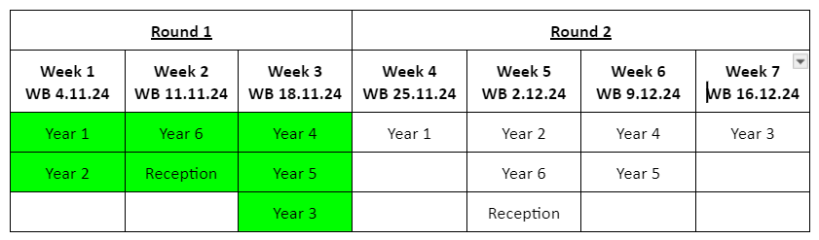
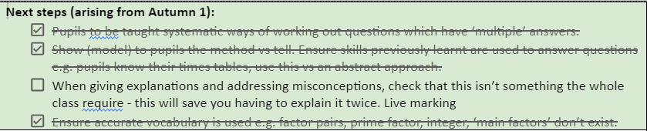
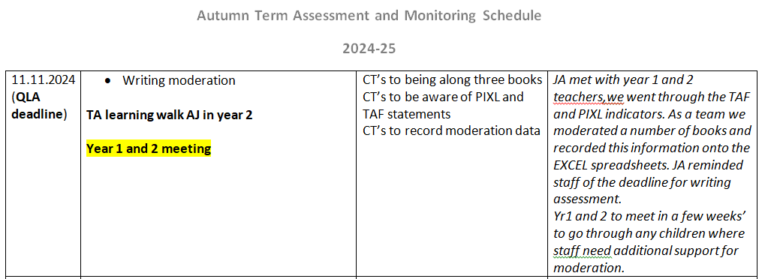
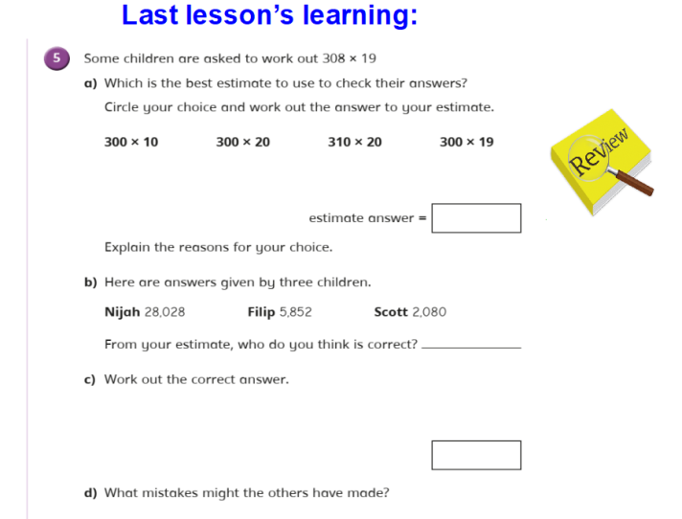
Quality of Education
YLs and SLT monitoring of all year groups (4 week cycle) with clear feedback to all teaching staff allowing teachers to adapt and respond as required. Next steps monitored.
IMPLEMENTATION
Singing assembly added to timetables to enable year teams to meet weekly to discuss assessment and monitoring priorities.
Teachers present subject matter clearly, promoting appropriate discussion about the subject matter they are teaching. They check learners’ understanding systematically, identify misconceptions accurately and provide clear, direct feedback. They respond and adapt their teaching as necessary.
(6)

Slide 8
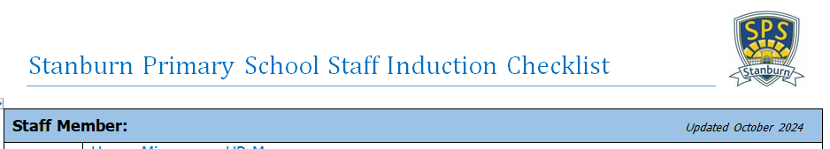

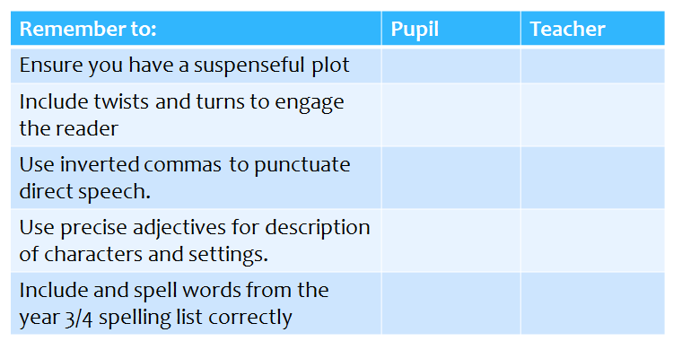

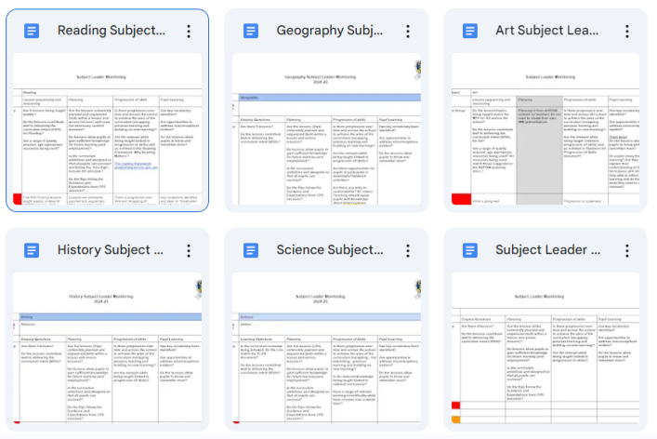
Quality of Education
IMPLEMENTATION
Clear lesson design structure with ‘icons’ and guidance and expectations for staff so that ALL lessons are designed around a set structure designed to help pupils learn and remember more. This is highlighted as a priority in our new staff induction checklist too.
Remember to:
Lesson Icons:
Subject monitoring:
Teaching is designed to help learners to remember content in the long term and to integrate new knowledge into larger concepts.
(7)

Slide 9
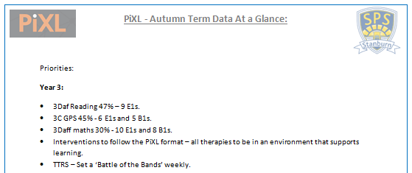
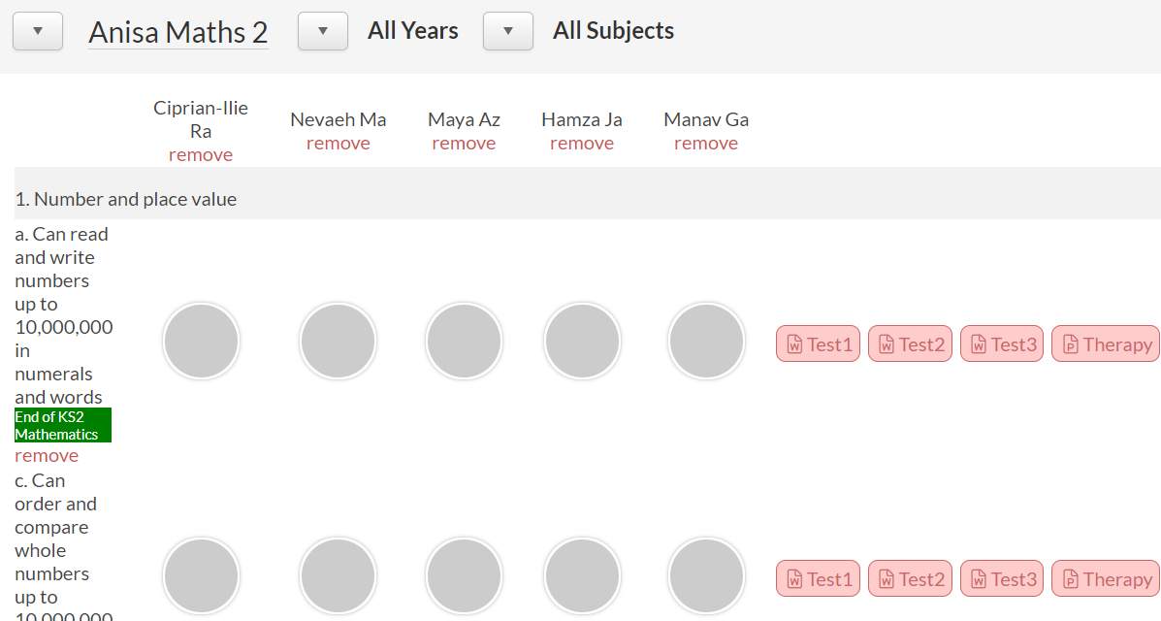
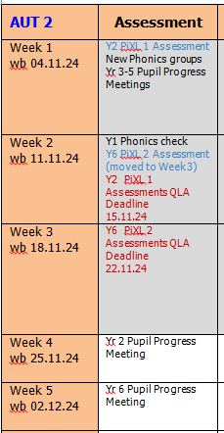
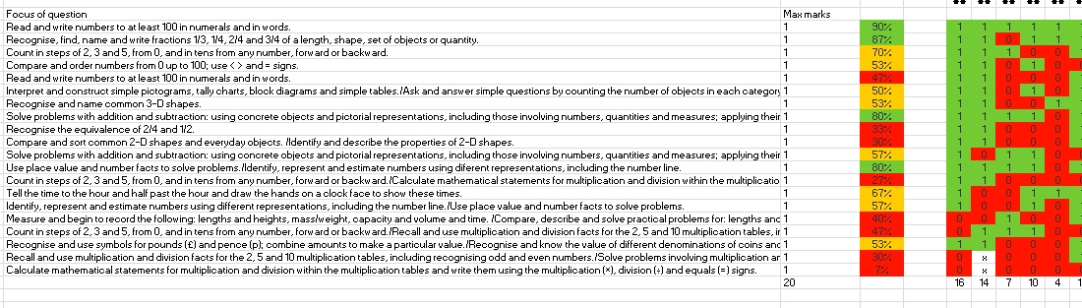
Quality of Education
RSL analysis of Autumn Term data – Priorities and next steps outlined and shared with Yls.
IMPLEMENTATION
QLAs completed for each pupil, in Reading, Maths and GPS for each assessment window. These are then used to inform planning, interventions and home learning.
PPMs planned after each assessment.
Teachers use assessment to help learners embed and use knowledge fluently or to check understanding and inform teaching.
(8)

Slide 10
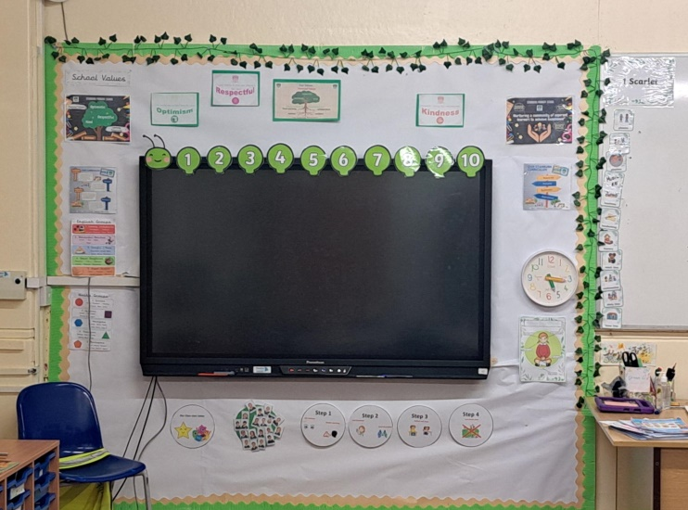

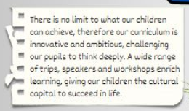
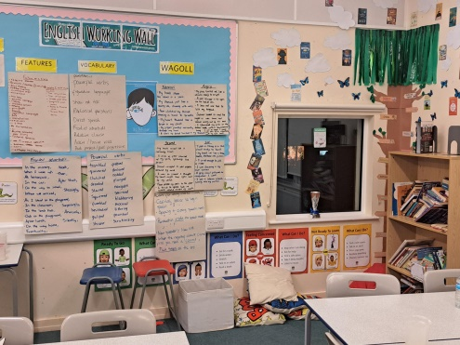

Quality of Education
PINs (Partners in Neurodiversity) Project begun. Actions shared with Yls including images. Learning environment checklist updated and circulated.
IMPLEMENTATION
‘Aim high – include all’
‘Aim High – Include All’ philosophy encouraged across the school to ensure a ‘ceiling’ isn’t put on pupils learning.
High quality resources and materials available for teachers to plan from
Teachers create an environment that allows the learner to focus on learning. Resources and materials used reflect ambitious intentions and clearly support a coherently planned and sequenced curriculum.
(9)

Slide 11


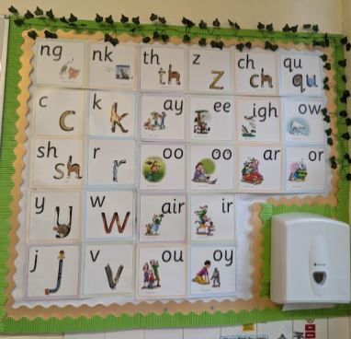
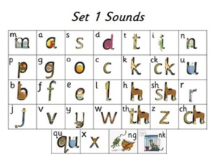
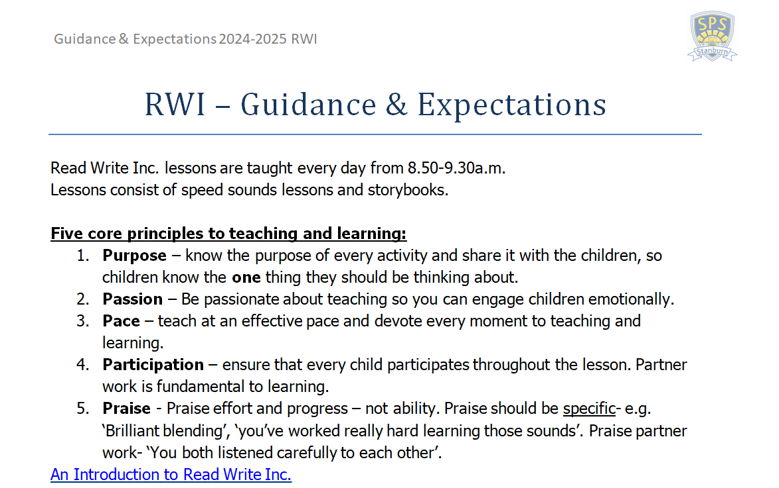


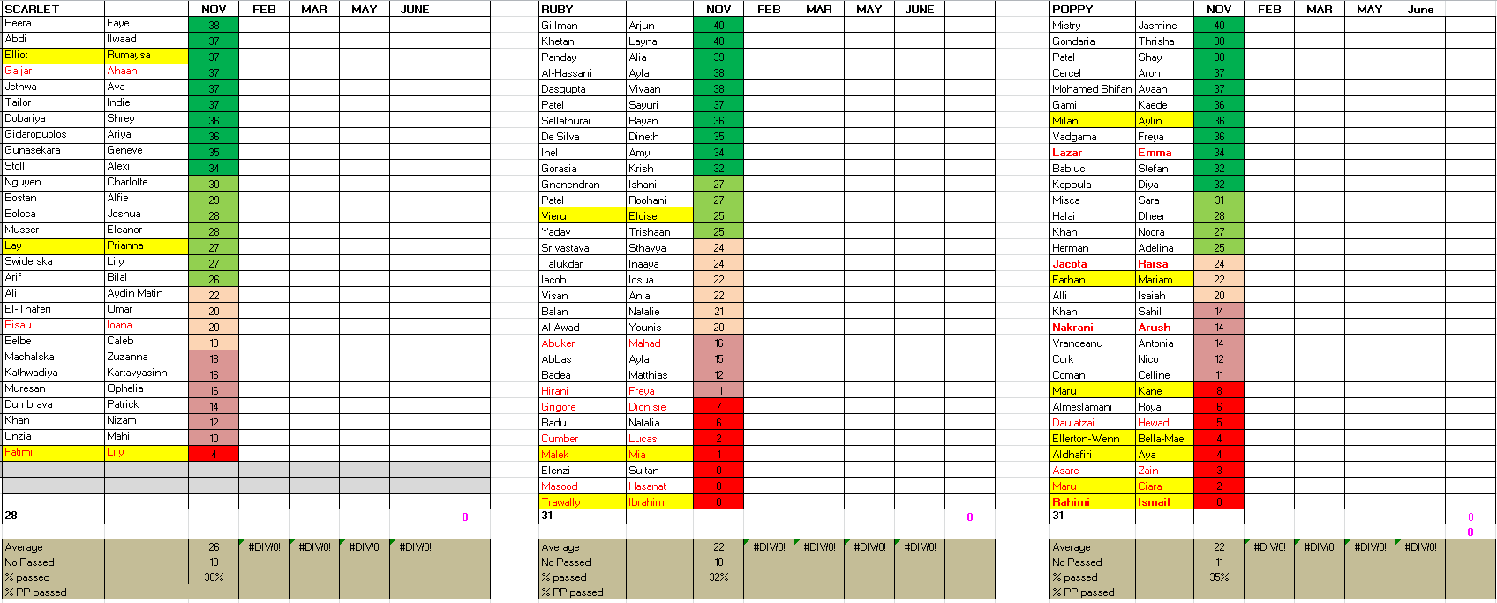
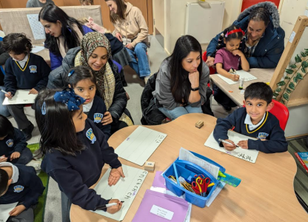

Quality of Education
Fidelity to the scheme is ensured as staff follow a clear lesson structure and maintain consistent learning environments. Guidance and expectations updated and followed by all. Monitoring, team teaching and targeted support provided.
IMPLEMENTATION
Targeted training, weekly CPD session and regular coaching ensures all staff are confident utilising the resources available to ensure high quality teaching of RWInc. and accurate assessment.
Parent workshops, meetings, signposting to resources and various lines of communication created to inform parents and encourage support with phonics and early reading at home
A rigorous approach to the teaching of reading develops learners’ confidence and enjoyment in reading. At the early stages of learning to read, reading materials are closely matched to learners’ phonics knowledge.
(10)

Slide 12
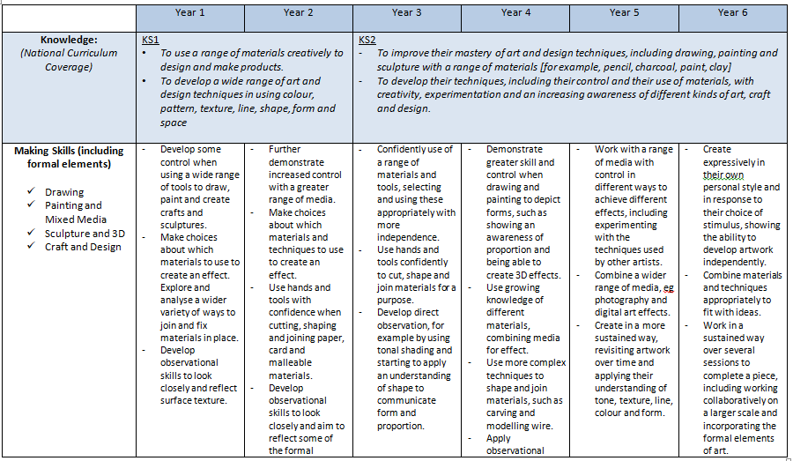
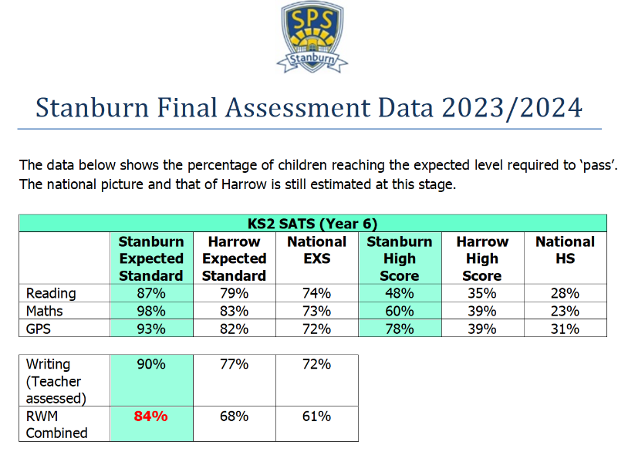

Quality of Education
School wide data consistently above national standards e.g. End of KS2 data for RWM = 85% vs 61% national.
IMPACT
Progression of Skills and Knowledge
Achievement is at the heart of our school vision and values.
Learners develop detailed knowledge and skills across the curriculum and, as a result, achieve well. Where relevant, this is reflected in results from national tests and examinations that meet government expectations, or in the qualifications obtained.
(11)

Slide 13
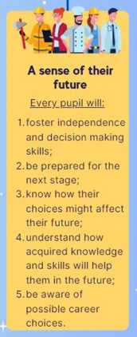
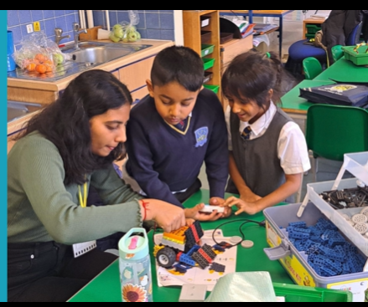
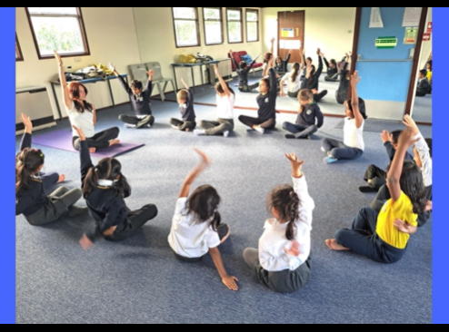
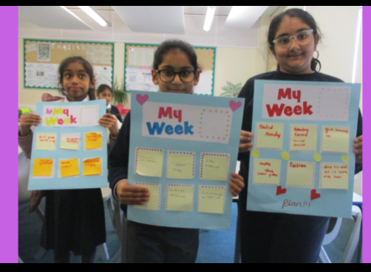
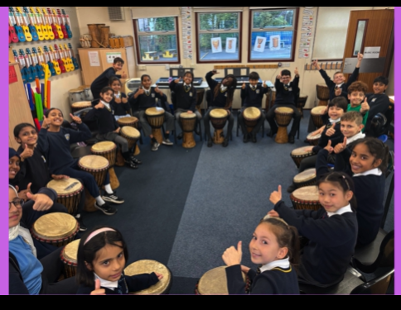
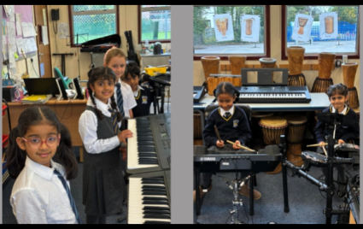
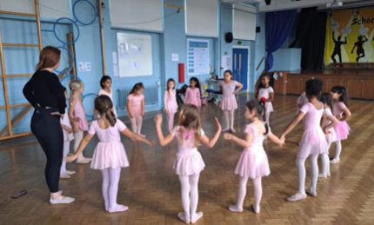

Quality of Education
School-wide commitment to ensure pupils leave Stanburn ‘prepared for their next stage’.
IMPACT
(12)
Pupils at Stanburn are offered a substantial range of extra-curricular clubs to allow them to gain skills and qualifications across a range of interests preparing them for the next stage of their learning.
Robotics
Yoga
Mindfulness
Rock Steady
African Drumming
Ballet
Pre-transition visits for key pupils.
Learners are ready for the next stage of education. They gain qualifications that allow them to go on to destinations that meet their interests, aspirations.

Slide 14



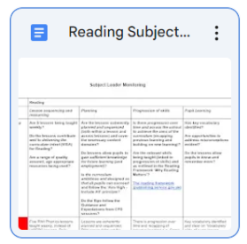

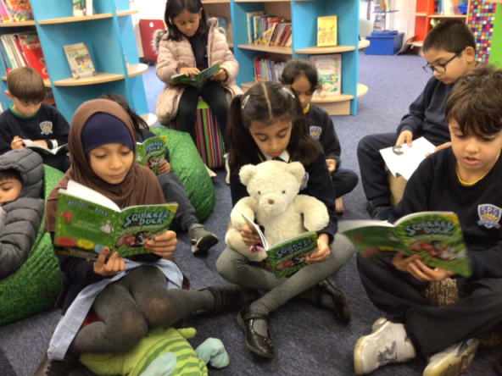



Quality of Education
Time to Read!
9am – 9:30am pupils across the whole school read either in phonics groups or VIPERS lessons.
Book at Bedtime events for Reception and Year 1
IMPACT
Monitoring of reading planning across the school and CPD delivered to ensure all teachers have the skills needed to ensure children read with fluency and comprehension.
Library Club in full swing!
Stanburn’s reading vending machine encourages pupils to read for pleasure and gives them the ‘gift’ of reading.
Live lessons with popular authors organised to encourage children to have a love of reading and expose them to new authors and books.
Two visits a year by the Book Fair allows pupils the chance to purchase high quality texts.
Children read widely and often, with fluency and comprehension.

Slide 15
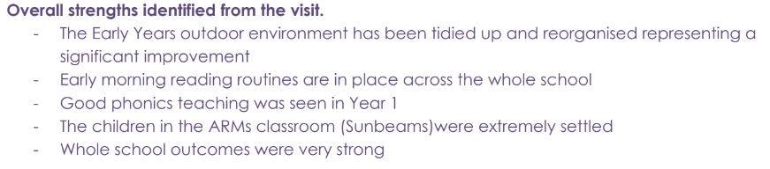
But don’t just believe us….

