Slide 1

Spring Term
Teaching and Learning Update
Katherine Hartland
Deputy Headteacher

Slide 2

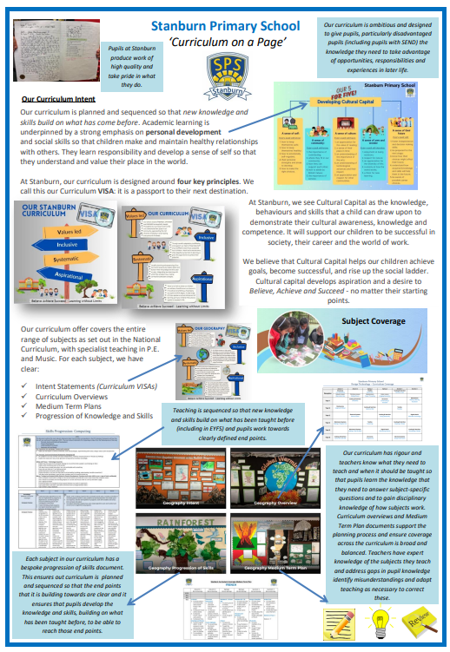
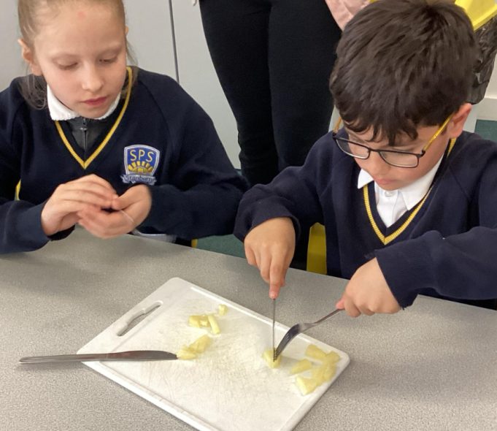
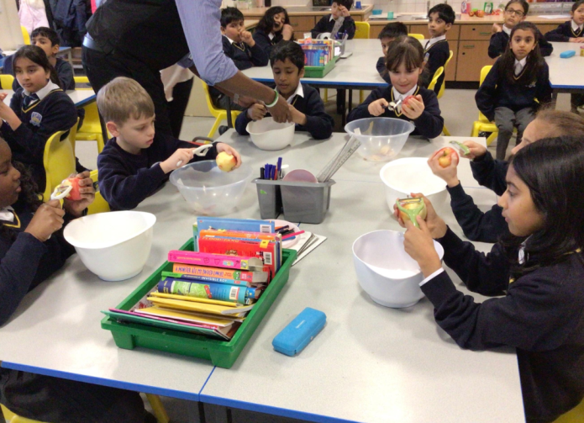
Teaching and Learning – Spring Term Update:
INSET day session on Stanburn’s Curriculum.
Learning walks to review provision of wider curriculum with YLs: Science, History, RE, DT, Art.
Pupil Voice collected to gauge pupil
opinion of their learning.
Monitoring by subject leaders against school’s
curriculum guidance and expectations.
Pupil Voice
What have you learnt in today’s lesson? I have learnt the word palaeontologist Mrs Hartland! That is someone who digs up fossils.
What is that on the table (pointing)? That is called ‘slip’. It’s a bit like glue and you use it to glue extra bits on your pots.
The children in the class were passionate about sharing their different experiences of ‘food around the world’ e.g.
I have been on holiday to Greece and visited an Olive Oil factory. This is because olives grow easily in Greece as it’s sunny.
I went to Kenya and it is very hot. I was able to pick mangoes off my grandma’s tree as there are lots of mangoes in Kenya.
Curriculum ‘on a page’

Slide 3
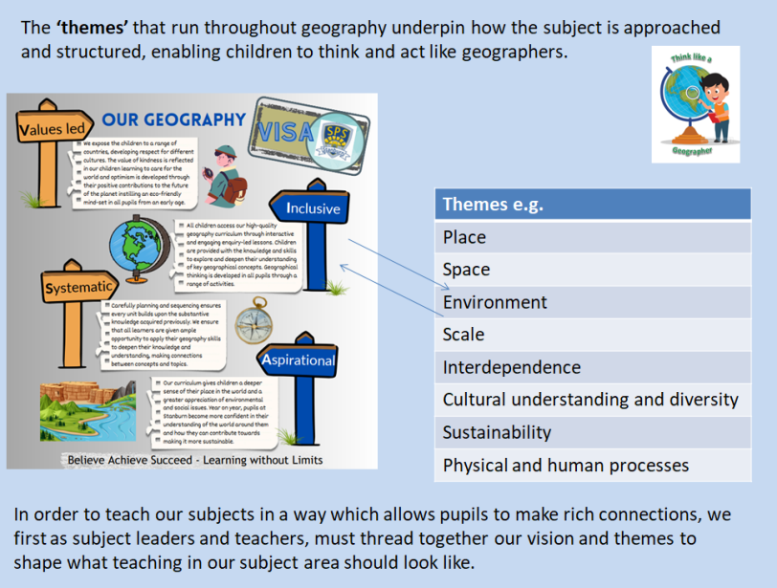
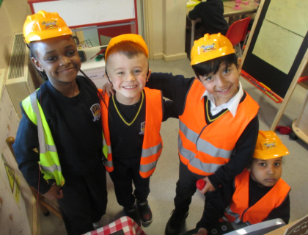
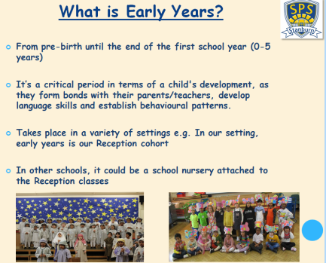
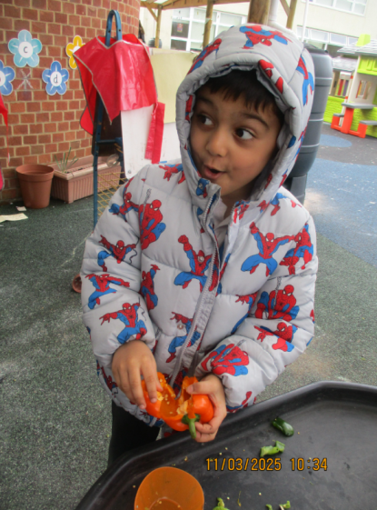
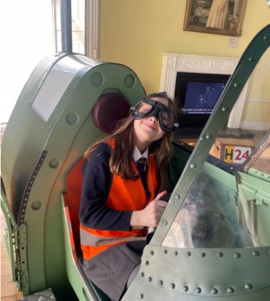
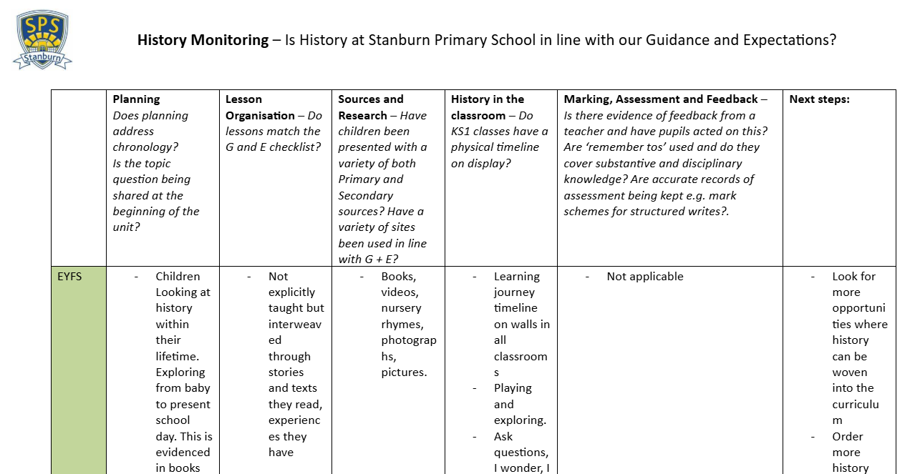

Curriculum feedback given to year groups to work on ready for the second phase of monitoring.
EYFS CPD show case
for all teachers.
CPD for all teachers on ‘themes’ across the curriculum in order to build ‘rich connections’
Reading: Every classroom was visited and the teaching of phonics and reading comprehension was seen. The improvement in the quality of phonics teaching is most visible. Due to outstanding leadership the quality of provision is now consistent across classes and the predicted data is very strong.
SIP visit to look at Reading and Writing across the school.

Slide 4
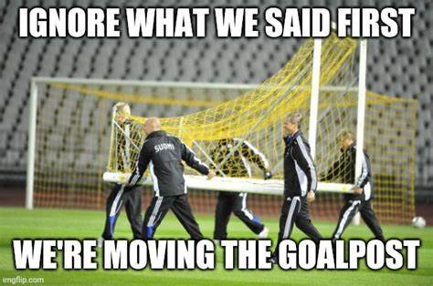
However…

Slide 5
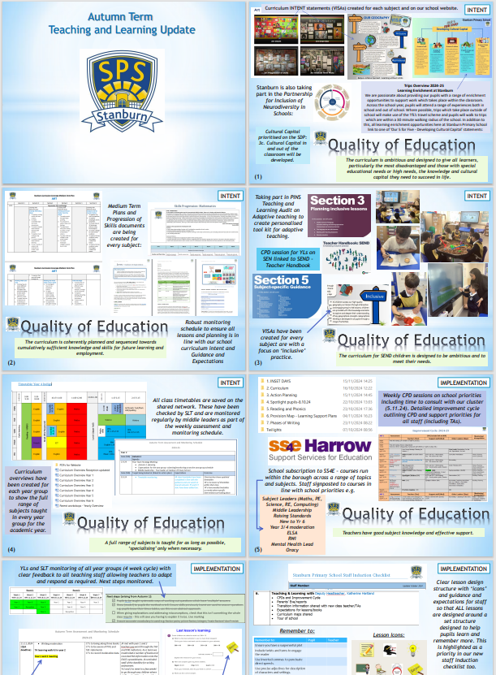
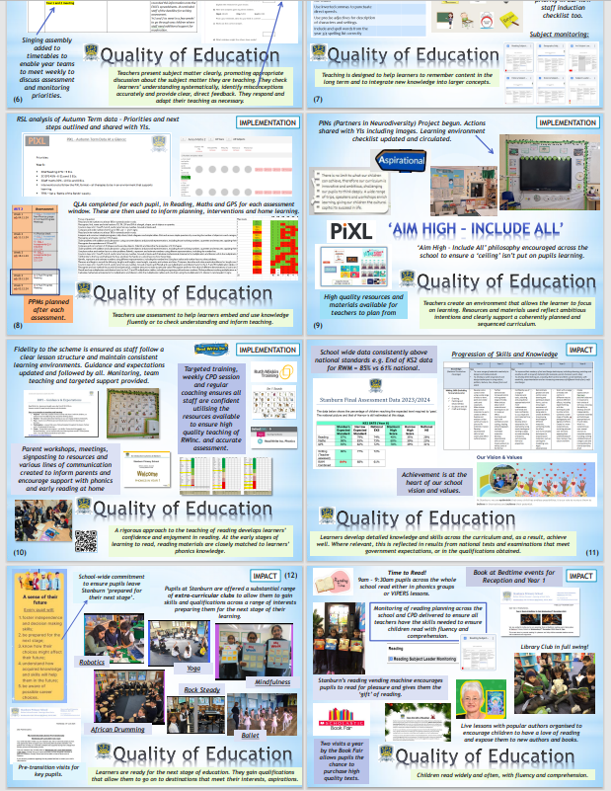

Slide 6
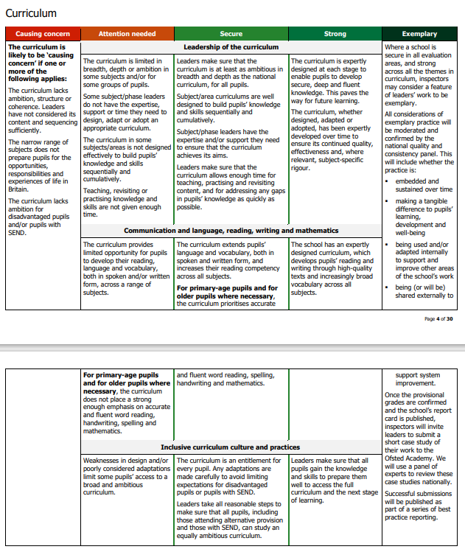
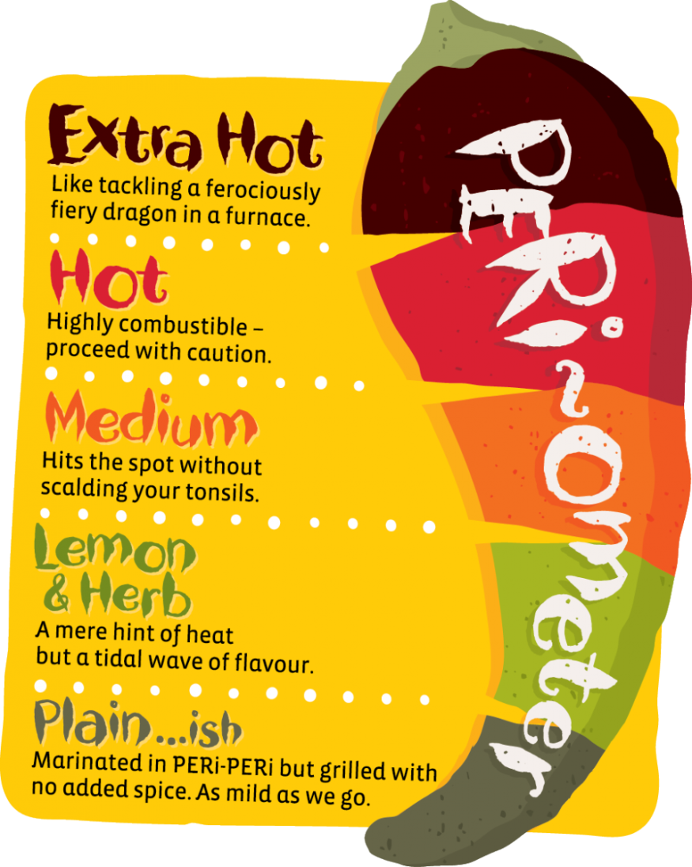
February 2025
Ofsted is proposing significant changes to its school inspection framework, aiming to provide a more nuanced evaluation of school performance. A key component of this overhaul is the introduction of a "report card" system that assesses schools across multiple specific areas, moving away from the traditional single overall rating.
Each specific area will be rated on a five-point, colour-coded scale:
Exemplary
Strong
Secure
Attention Needed
Causing Concern

Slide 7

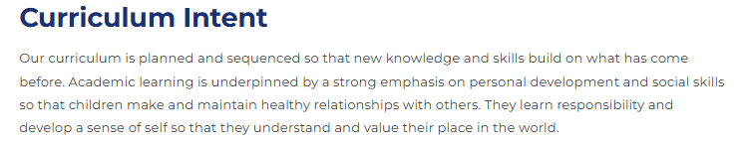
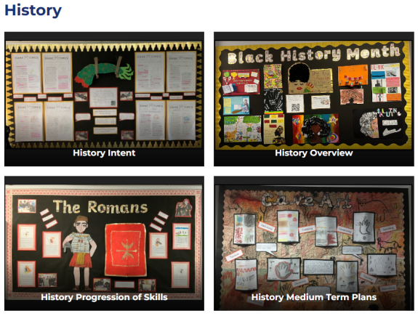
The Curriculum:
Within this new framework, the curriculum is a primary focus. Schools are expected to design and implement a curriculum that is:
Broad and Balanced: Ensuring all students have access to a wide range of subjects and learning experiences.
Sequenced and Coherent: Content should be logically structured to build upon prior knowledge and facilitate progression.
Inclusive: Catering to the diverse needs of all students, including those with special educational needs and disabilities (SEND).
Impactful: Demonstrating that the curriculum
leads to positive student outcomes, both
academically and in personal development.
Our website is also up-to-date with our full curriculum offer which includes: Curriculum Intent (VISAs), Subject overviews, Subject MTPs and Progression of Skills documents.
Stanburn Primary School - Subject Coverage

Slide 8
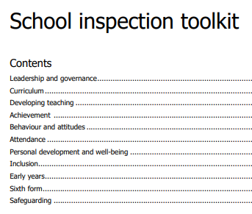
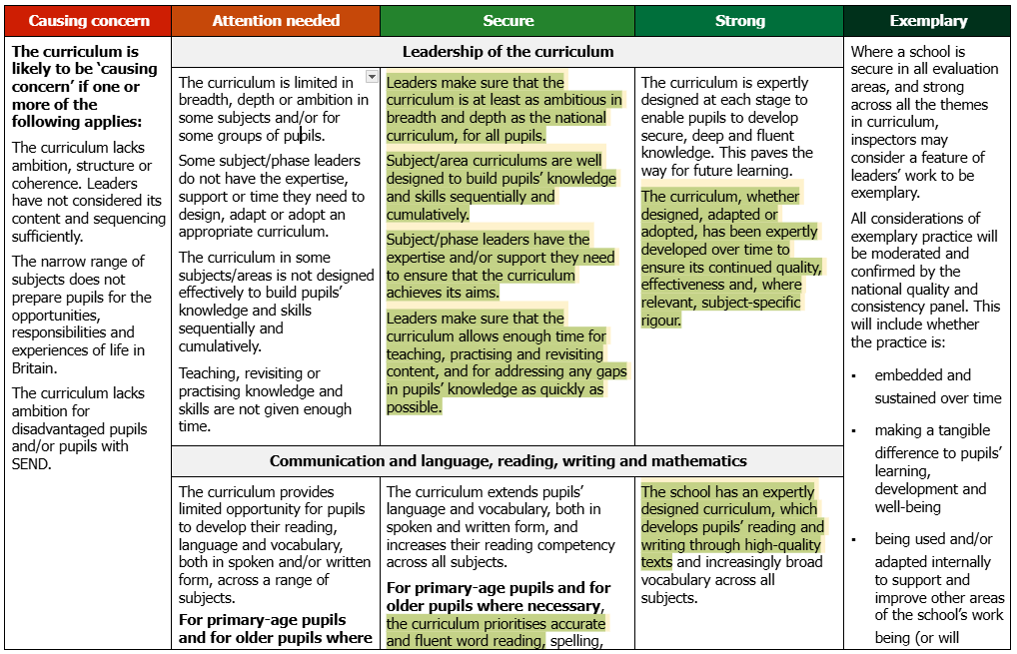
Inspection Toolkits:
To assist schools in aligning with their new expectations, Ofsted has developed "inspection toolkits." These toolkits provide detailed descriptors for each grading level across the assessment areas, clarifying what inspectors look for during evaluations.

Slide 9

Curriculum:
Stanburn’s self-evaluation of our curriculum is strong moving into secure once all of our initiatives e.g. a drive on vocabulary and oracy, have been embdeded.
Stanburn's motto is 'Believe, Achieve, Succeed' and we ensure that all pupils receive a curriculum offer which is ambitious.
Simon Adams (SIP) said: “The leadership of the Headteacher and her senior leaders is exemplary. They work so hard to ensure that staff are buying into a way of working which ensures high standards.”
Aspirational – is one of the components of our curriculum VISA and threads through every subject.
Leaders make sure that the curriculum is at least as ambitious in breadth and depth as the national curriculum, for all pupils.

Slide 10
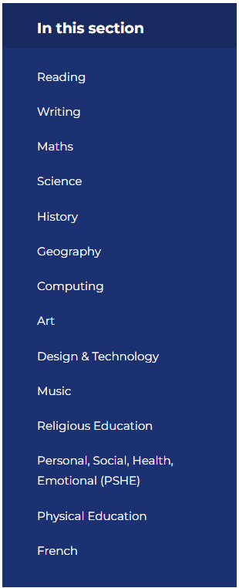
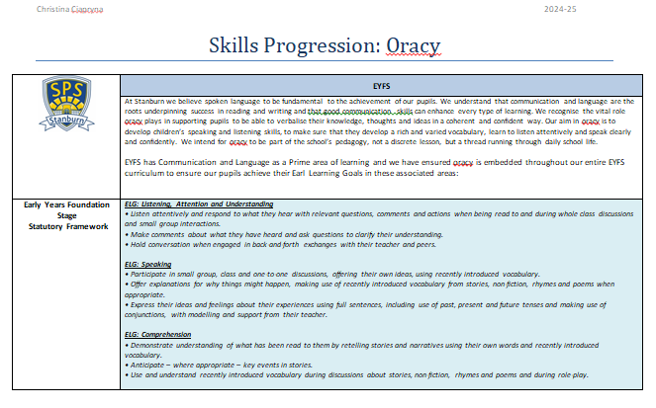
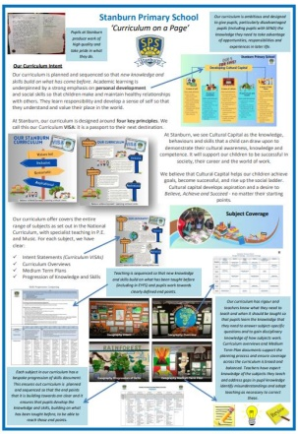
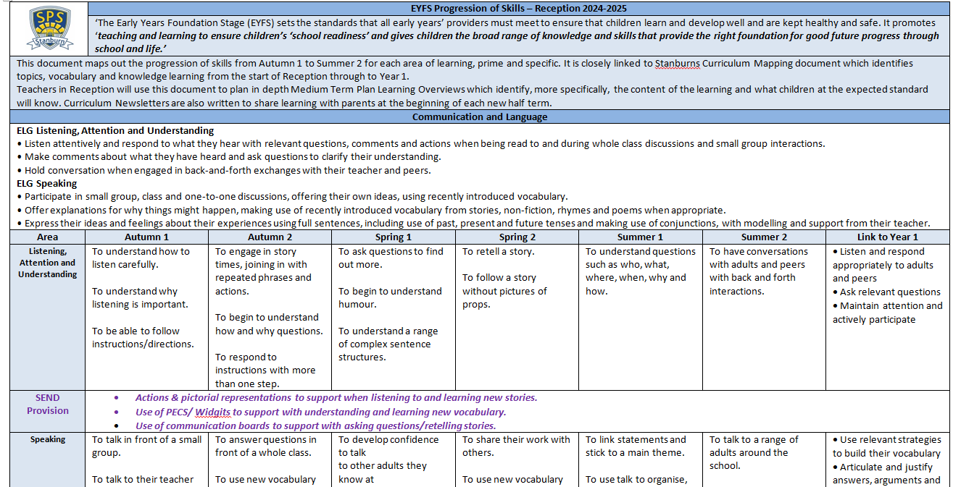
The curriculum, whether designed, adapted or adopted, has been expertly developed over time to ensure its continued quality, effectiveness and, where relevant, subject-specific rigour.
Each subject has its own progression of skills document adapted specifically for Stanburn. This also includes a specific EYFS document and one for Oracy which is one of our school priorities.
During the Spring INSET day our curriculum rationale was shared with all staff: see: ‘curriculum on a page’.
Assessment and Monitoring across the whole curriculum takes place regularly.
Oracy
Stanburn Primary School - Subject Coverage
EYFS

Slide 11

The curriculum, whether designed, adapted or adopted, has been expertly developed over time to ensure its continued quality, effectiveness and, where relevant, subject-specific rigour.
From EYFS to Year 6 the curriculum is designed and adapted to suit our school context.

Slide 12
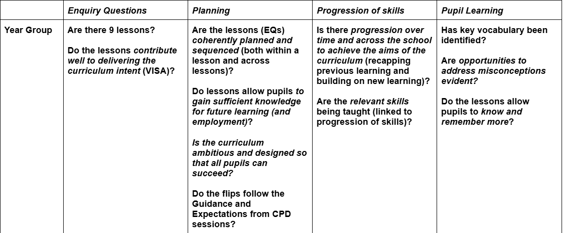
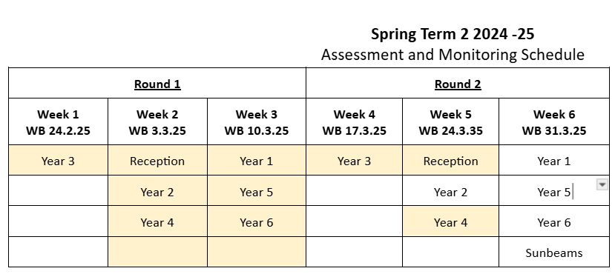
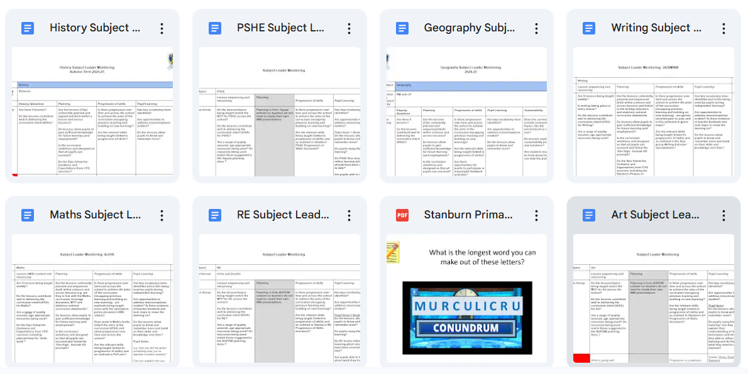
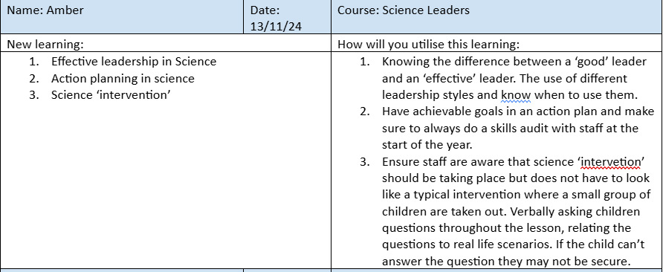
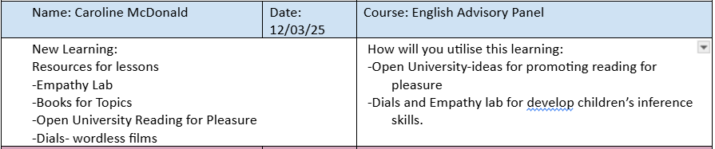
Year leaders and Subject Leaders are supported by SLT to monitor the curriculum ensuring it achieves its aim (VISA).
Staff are encouraged and signposted to attend training linked to their subject areas both within Harrow and using external providers.
Monitoring Docs
Subject/phase leaders have the expertise and/or support they need to ensure that the curriculum achieves its aims.
Training Log

Slide 13


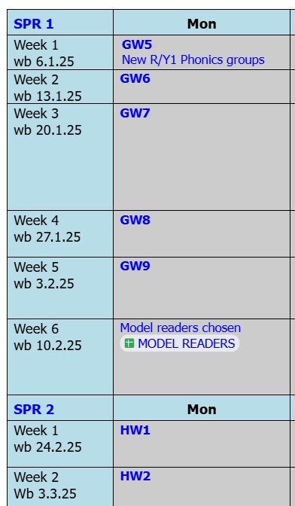

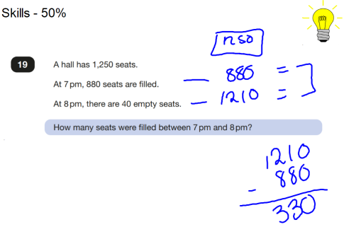
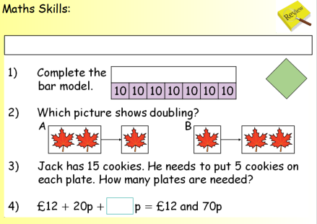

The curriculum is well planned and thought out through detailed medium term plans ensuring each subject is given the full amount of 'teaching time' required.
Subjects such as Geography and History are carefully mapped out on our school deadline calendar to ensure each year group know which ‘learning week’ they are currently on. This is consistent across the school.
Leaders make sure that the curriculum allows enough time for teaching, practising and revisiting content, and for addressing any gaps in pupils’ knowledge as quickly as possible.
Addressing gaps

Slide 14
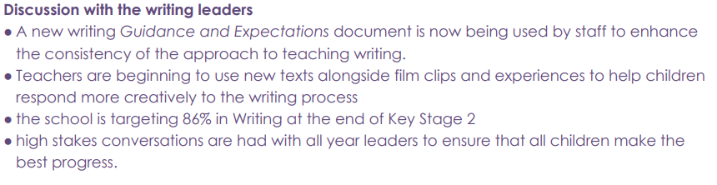

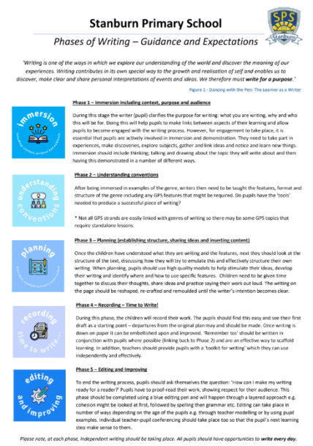
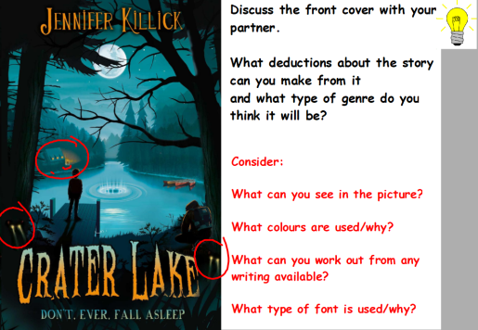

Bespoke curriculum developed across the school for reading (VIPERS) and writing.
G and E developed for Writing and Stanburn 'Phases of Writing' launched which includes 'immersion' phase ensuring pupils are exposed to high-quality texts.
The school has an expertly designed curriculum, which develops pupils’ reading and writing through high-quality texts and increasingly broad vocabulary across all subjects.
G & E
Bespoke writing curriculum
VIPERS Texts

Slide 15

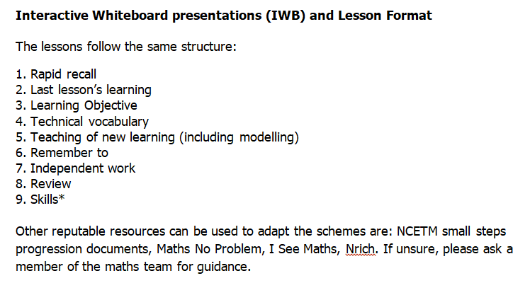
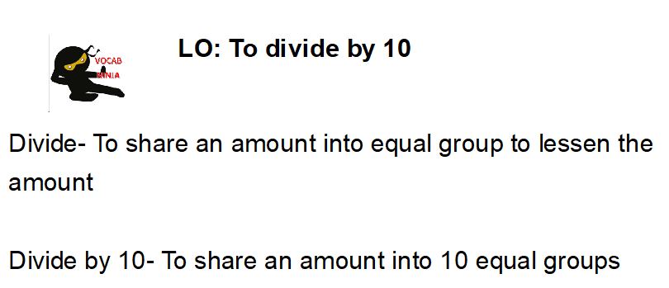

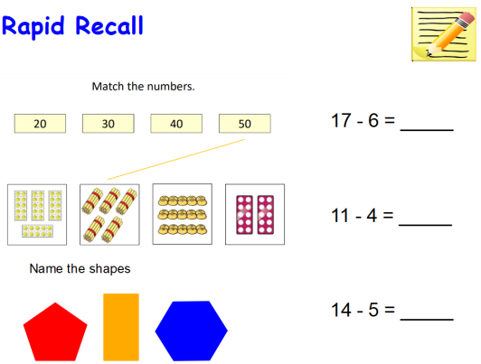
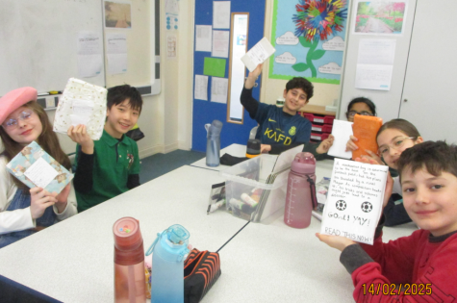
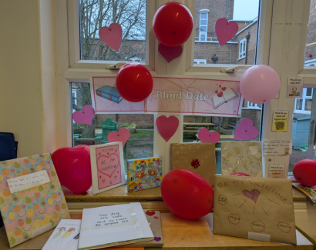
For primary-age pupils and for older pupils where necessary, the curriculum prioritises accurate and fluent word reading, spelling, handwriting and mathematics.
G & E
Reading is prioritised (RWI and VIPERS all taught at 9am across the whole school),
Maths lesson structure embedded and prioritised leading to high outcomes e.g. KS2 98% of pupils achieved EXS in Maths.
Vocab Ninja
Rapid Recall Year 5 and Year 1

Slide 16
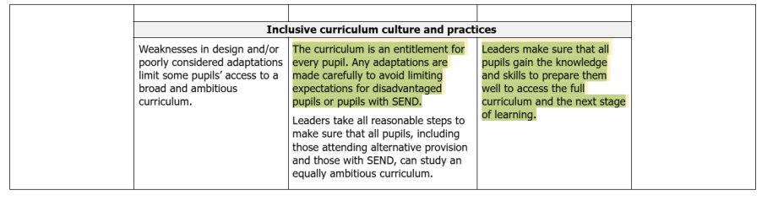
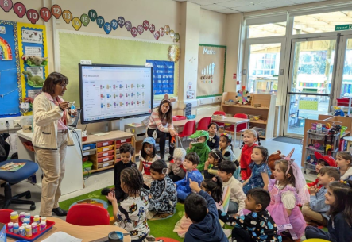

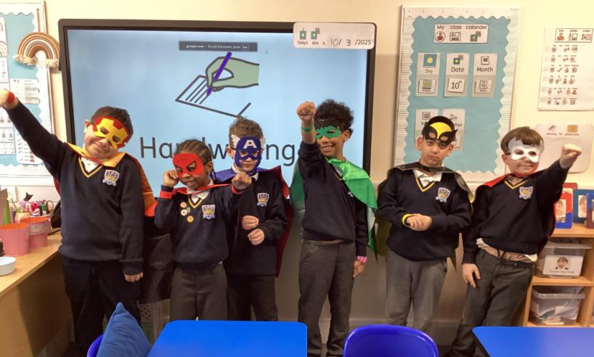
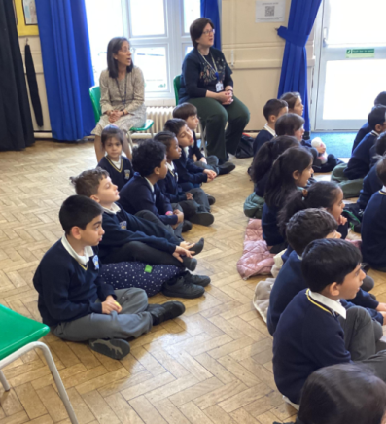
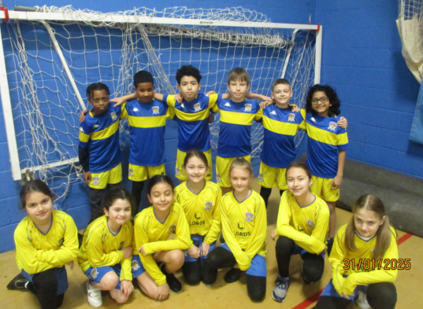
The curriculum is an entitlement for every pupil. Any adaptations are made carefully to avoid limiting expectations for disadvantaged pupils or pupils with SEND.
All pupils (including those in Sunbeams) have access to an inclusive curriculum.
Delivering a broad and balanced curriculum is embedded into all teaching practices.
Adaptive teaching has been a key focus for us this term at Stanburn.
Class Dojo showcases the breadth and depth of the curriculum on offer here at Stanburn.

Slide 17
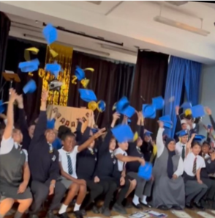
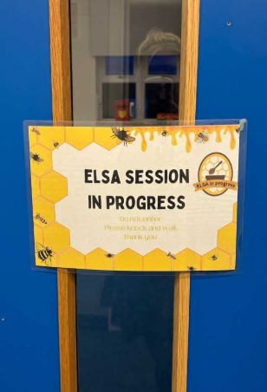
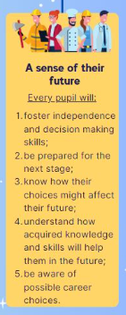
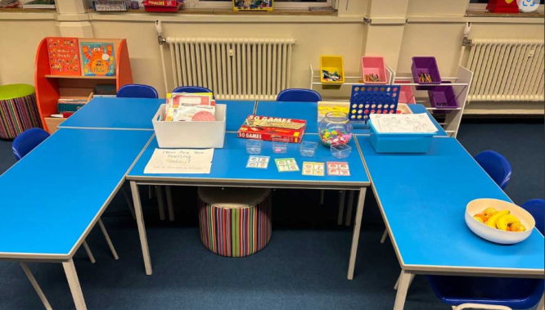
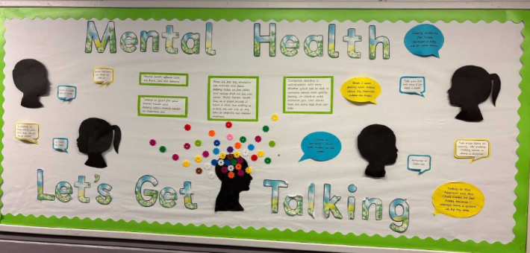
Pupils are ready for the next stage of their education.
Pupil Wellbeing Mentors, teachers and leaders prepare pupils to gain the knowledge and skills they need for life beyond Stanburn.
Cultural capital is a strength of the school.
Leaders make sure that all pupils gain the knowledge and skills to prepare them well to access the full curriculum and the next stage of learning.
Stanburn Primary School - Cultural Capital

Slide 18
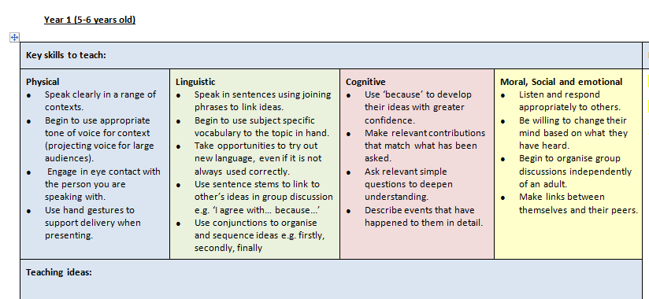
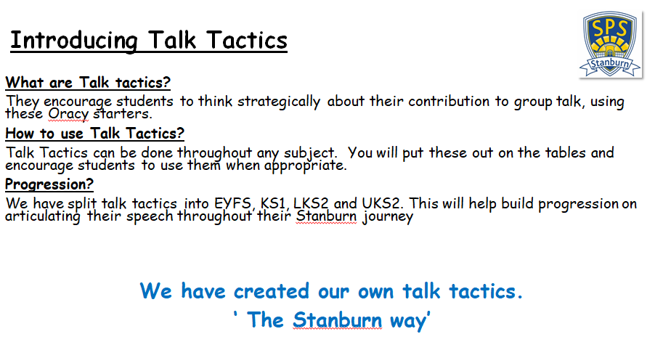


Next steps:
Secure
Communication and language needs to be embedded across the school. The curriculum extends pupils’ language and vocabulary, both in spoken and written form, and increases their reading competency across all subjects.
Spelling and handwriting needs to be consistent and prioritised across the school (September 2025).
SEND curriculum (e.g. those in
alternative provision) is ‘equally
ambitious’. Leaders take all
reasonable steps to make sure
that all pupils, including those
attending alternative provision
and those with SEND, can study an
equally ambitious curriculum.

Slide 19



Next steps:
Strong
Pupils knowledge in the curriculum should enable pupils’ knowledge to be ‘secure, deep and fluent’. The curriculum is expertly designed at each stage to enable pupils to develop secure, deep and fluent knowledge. This paves the way for future learning.
The curriculum needs to be designed to ensure vocabulary is a focus across all subjects: increasingly broad vocabulary across all subjects.
We now need time to embed our curriculum and ensure the progression of skills are now being utilised by all.

Slide 20


