Slide 1

Spring Term 2026
Teaching and Learning Update
Katherine Hartland
Deputy Headteacher

Slide 2

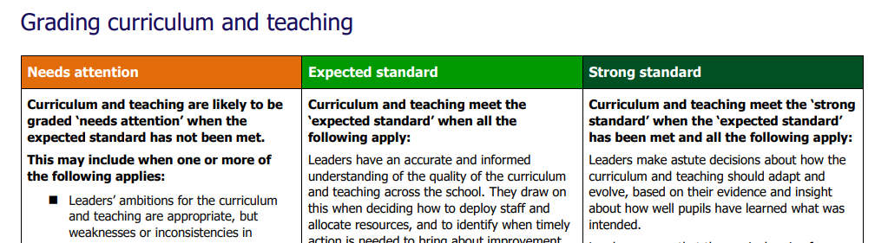
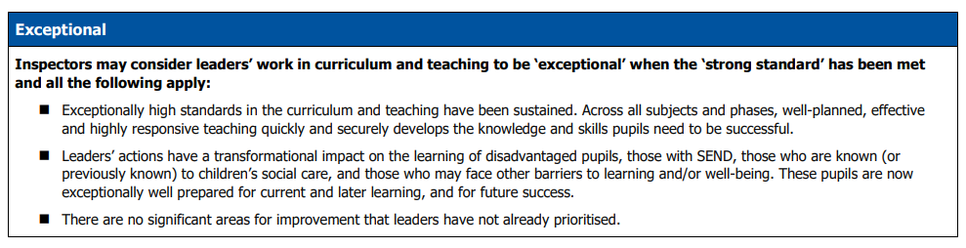
OFSTED
3. Curriculum and Teaching

Slide 3

Curriculum Intent – What is taught and why?
Our curriculum VISAs for every subject outlines our vision for each subject. Learning at Stanburn is: Values Led, Inclusive, Systematic, Aspirational. Our curriculum is planned and sequenced so that new knowledge and skills build on what has come before. Academic learning is underpinned by a strong emphasis on personal development and social skills so that children make and maintain healthy relationships with others. They learn responsibility and develop a sense of self so that they understand and value their place in the world. Each subject’s specific VISA is detailed on our school website here.
Since our last inspection, our curriculum has moved from being teacher expertise dependent to intentionally structured, research-informed, and progression-driven across all subjects.
A key development has been greater clarity around when we adopt, adapt, or design curriculum content
ADOPT – ADAPT - DESIGN

Slide 4
ADOPT – ADAPT - DESIGN
Adopted where high-quality, well-sequenced schemes align with our vision and reduce unnecessary workload e.g. Kapow used for Art, DT and RE to ensure:
- Clear progression of skills and knowledge
- Subject-specific rigour
- Staff confidence in foundation subjects
ADOPT
Adapted where we wanted strong frameworks but need alignment with school priorities: e.g. Science adapted to be enquiry-led, guided by PLAN documentation, reflecting our PSQM accreditation and commitment to working scientifically and Maths adapted from White Rose, ensuring:
- Conceptual depth
- Coherence and progression
- Flexibility to meet pupil needs rather than following the scheme mechanically
ADAPT
Designed in-house where subject knowledge, context, literacy links or where previous inspection feedback were priorities: English, VIPERS (guided reading), History & Geography
These are planned by teachers using subject leader expertise, progression documents, and clear expectations, ensuring consistency without removing professional agency.
DESIGN

Slide 5
Implementation - How is the curriculum delivered?
Each subject taught at Stanburn has a detailed medium term plan to outline each unit and lesson taught across the year.
VIPERS/Phonics/Reading, Maths and English are taught daily across the school and then other subjects are taught weekly. Some units, for example Geography and History, are organised into two 9 week blocks which allow pupils to explore a Topic Question in more detail.
Pupils at Stanburn are also taught PE twice weekly either by their class teacher or our specialist PE teacher. Pupils are also taught music lessons weekly by our specialist music teacher and attend singing assembly each week.
Subject overviews and MTPs can be found on the website here.
Curriculum newsletters are also sent to parents termly, outlining the curriculum coverage for each year group.

Slide 6
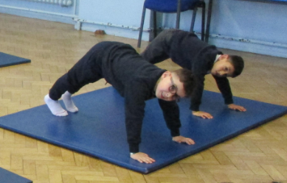
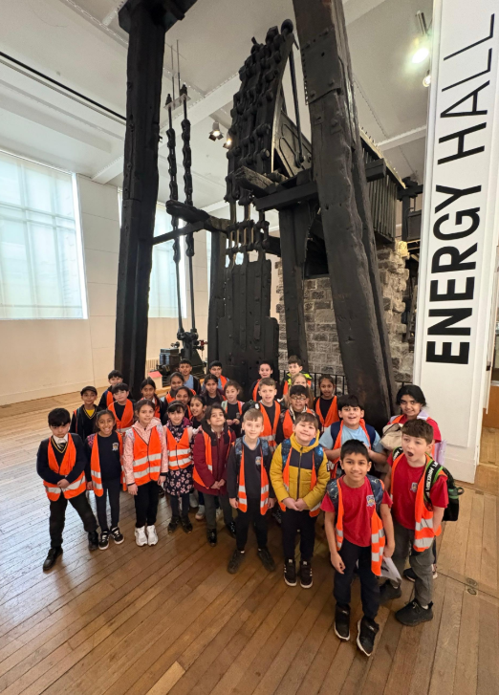
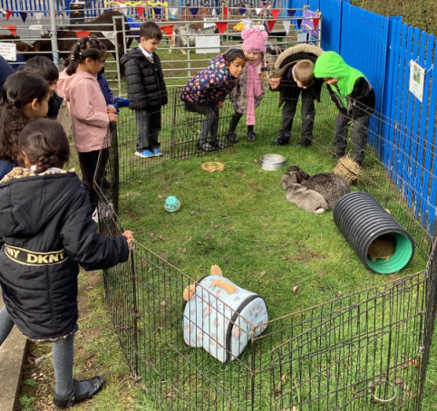
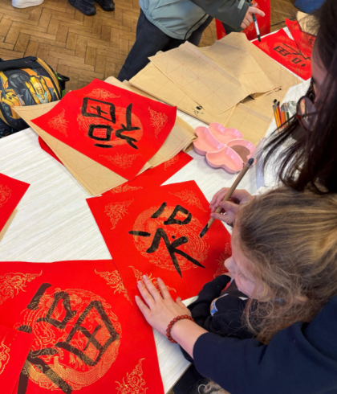
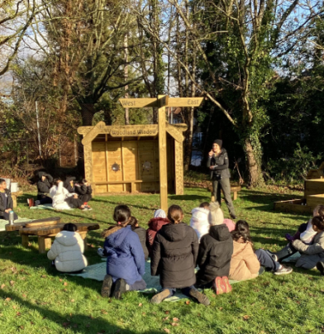

Personal Development – What does this look like at Stanburn?
It is about nurturing the whole child, preparing them not only for secondary school but for life beyond education.
Educational Visits (mapped out across the year and linked to our 5 for 5)
Religious and Cultural Festivals Calendar
Recognition of national events e.g. STEM week, National Career’s Week, World Book Day, RSPB Big Birdwatch etc.
Extra-curricular club offer
Curriculum enrichment e.g. Forest School classes, Yoga sessions, Drama workshops, Music workshops
Pupil Well-being mentors, PSHE curriculum
Sporting competitions and opportunities
Assembly calendar and guest speakers
School-wide events e.g. Stanburn’s Got Talent

Slide 7
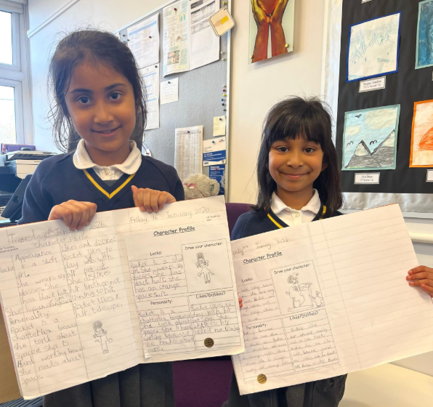
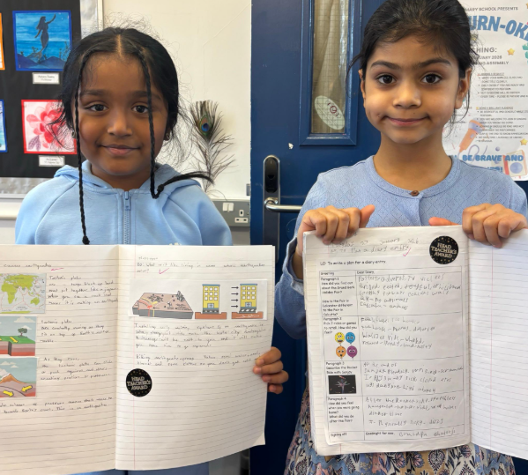
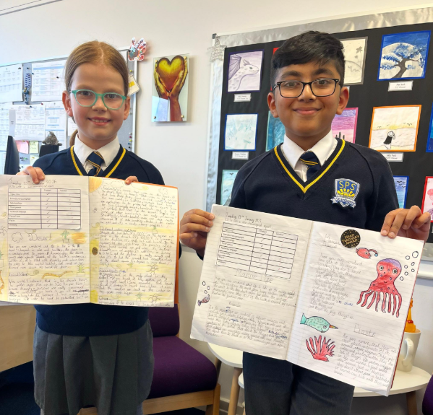
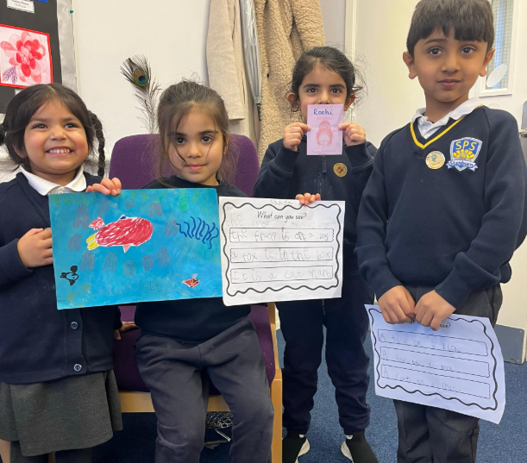
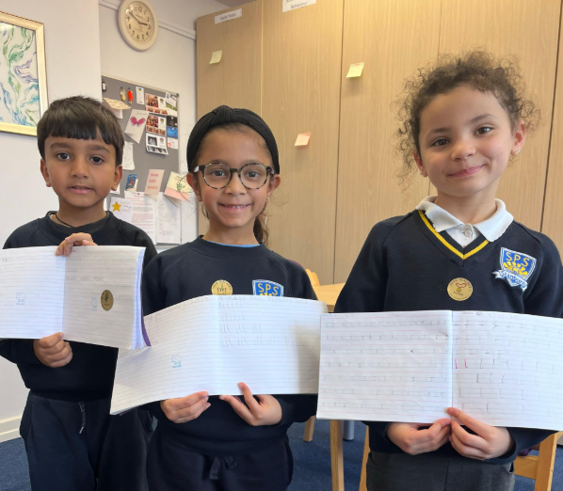
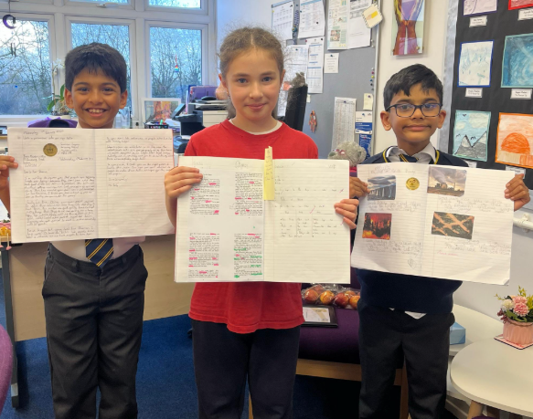
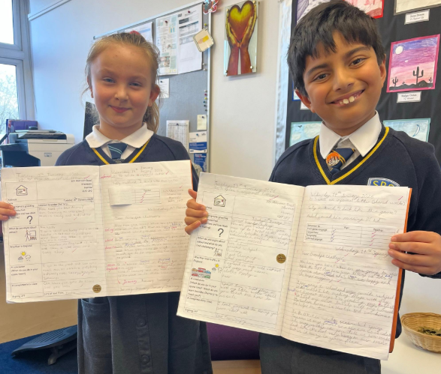
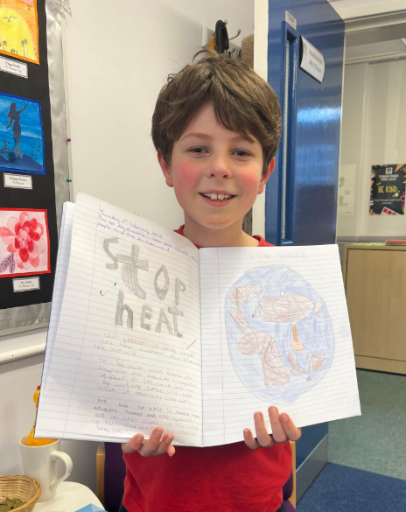
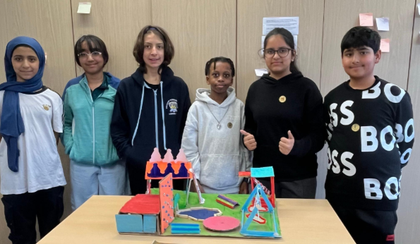
Impact?
Happy, proud, successful, articulate and amazing children!

Slide 8

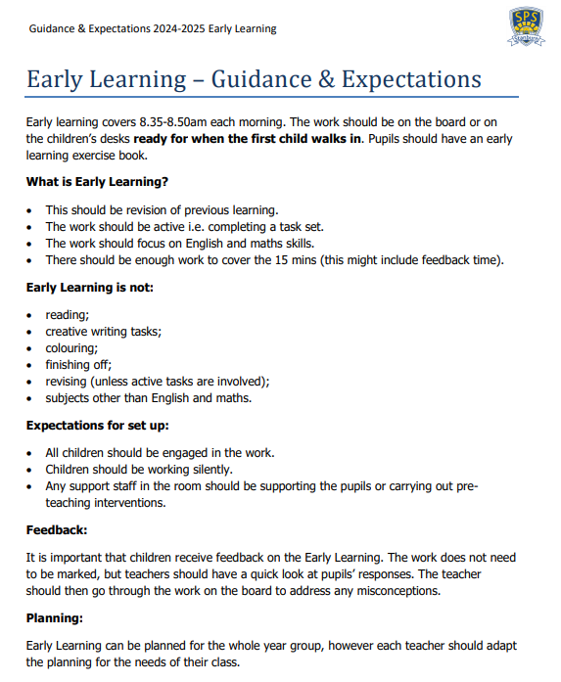
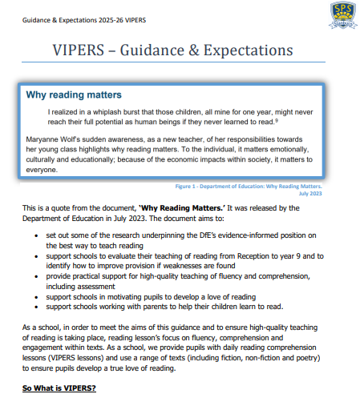
Pedagogical approach and Quality of Education
Teaching and learning at Stanburn is approached systematically and all pupils are given the tools they need and opportunities to ‘Believe, Achieve, Succeed’. In order to do this, it is essential that learning is aspirational.
Guidance and Expectation documents are available for each subject which clearly outlines the way that subject should be planned for, resourced, delivered and assessed.
Regular monitoring (weekly) takes place across the curriculum with strengths and next steps shared with staff at the end of each monitoring cycle.

Slide 9
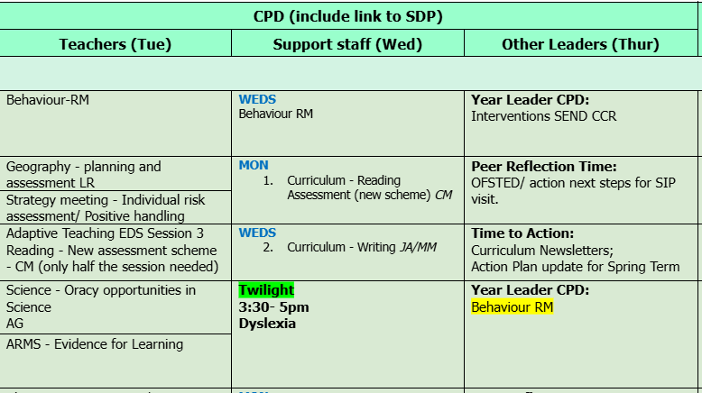
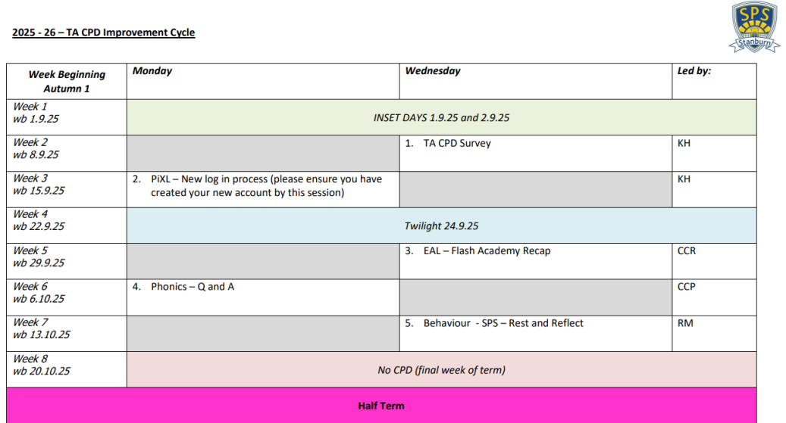
Teacher development, CPD, professional learning
Teachers
Teacher professional development is carefully thought out and outlined on our school improvement calendar.
ECTs
ECTs are also given an additional 10% non-contact time in order for them to access development materials and meet with their mentors weekly.
Support Staff
TAs also have their own bespoke development cycle which was created following staff feedback and needs.
Subject Leaders
Subject CPDs are planned based on upcoming priorities following monitoring visits and each term there are also sessions linked to our school improvement priorities e.g. Adaptive Teaching, TA deployment, Curriculum EDI.

Slide 10
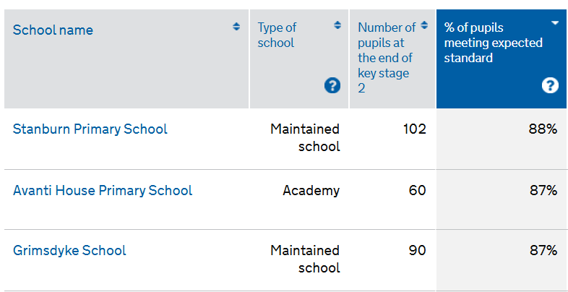
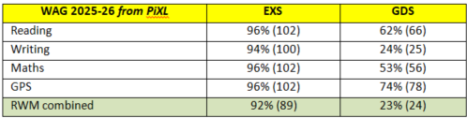
Assessment – What does this look like at Stanburn?
In the moment marking is used across the school to give pupils instant feedback on their learning. Teachers provide feedback to pupils using pink pen and pupils self-assess or edit their work using blue pen.
Writing conferencing (structured conversations with pupils about their written work) is also used as a tool to give instant feedback and model to pupils how to edit and improve their work independently.
DTTR (diagnose, therapy, test, revisit) is also used across the school linked to our PiXL assessment cycle. QLAs (question level analysis) and data wisdom is used to inform interventions, adapt planning, close gaps in learning and ensure all pupils achieve their potential.

Slide 11

Curriculum evolution and development priorities: What next?
Our school development plan consists of 5 key priorities for 25-26.
The curriculum focus this academic year is, ‘To ensure our curriculum is inclusive and all pupils feel represented.’ This is being achieved through updating planning to include characters and stories which represent the pupils at Stanburn whether that be those who are from different cultures or faith or those who are neuro-diverse.
With curriculum structures, progression documents and medium-term planning now established across subjects, our focus has shifted from building the curriculum to deepening its impact.
This marks a shift from Curriculum as structure → Curriculum as experience. We are asking not just: Is knowledge sequenced? But also: Whose stories are told? Who is visible? Who feels this curriculum is for them?

Slide 12
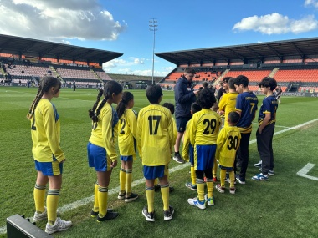

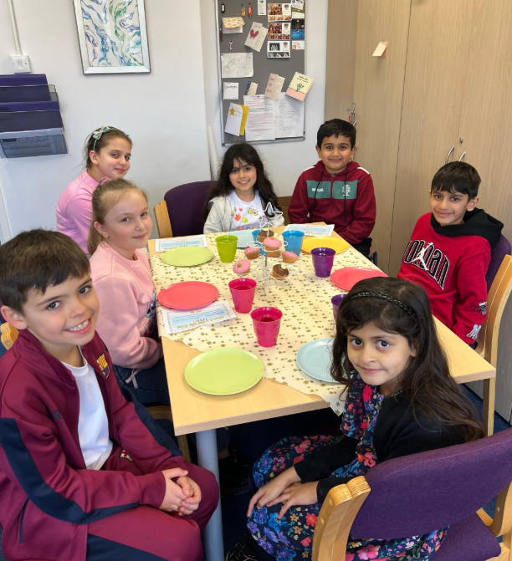
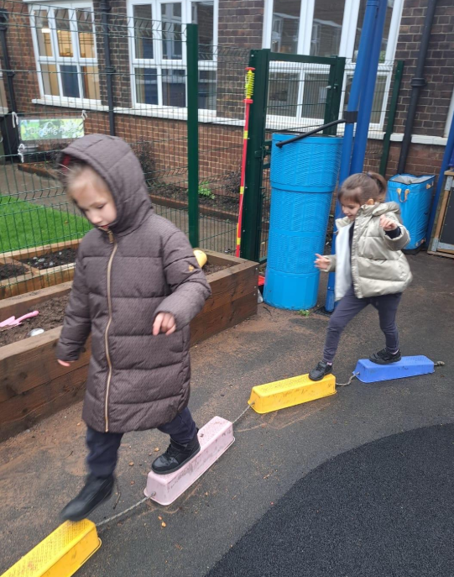
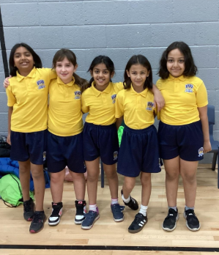
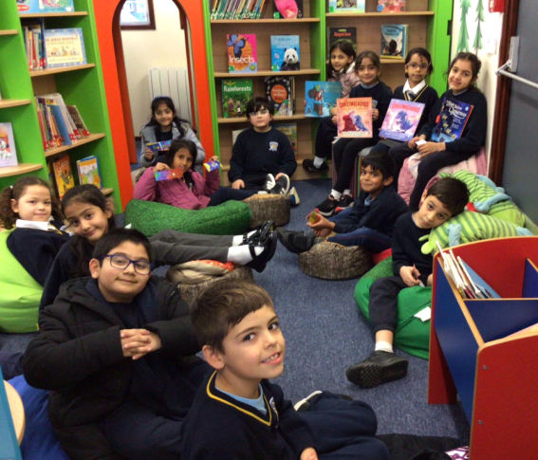
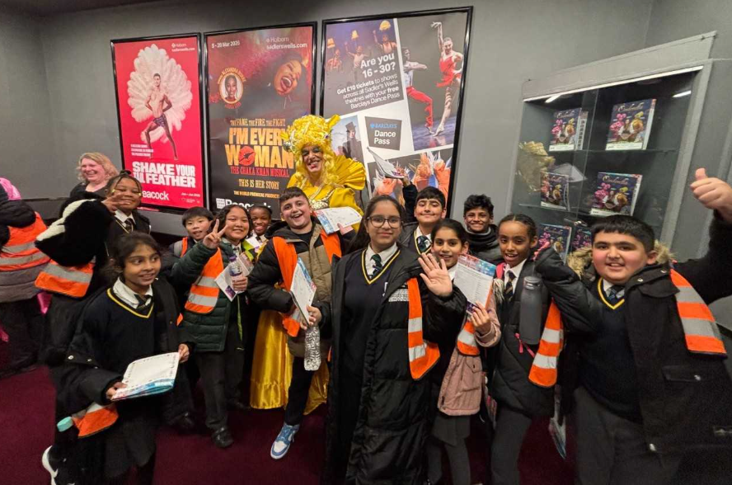
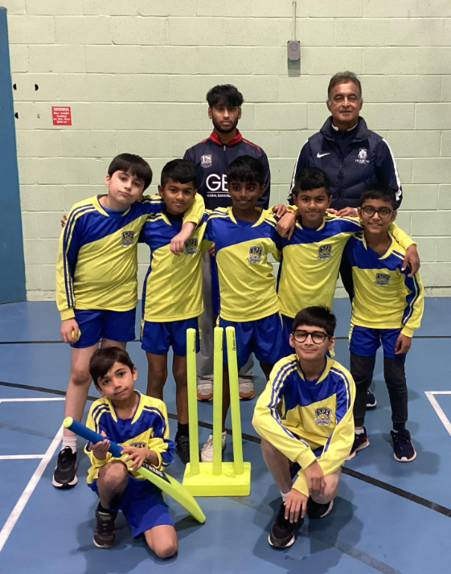
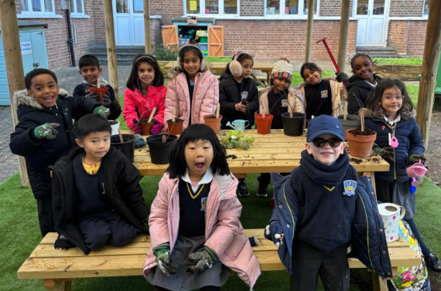
SEND pupils
Pupils known to children’s social care
Bereavement
ASD
Young carers
ADHD
EAL
Pupil Premium
Individual Healthcare Plan

Slide 13


